Slide 1

Numpy, Pandas, Visualization - Part 2
Indexing, Slicing and Array Operations

Slide 2
Array Indexing

Slide 3
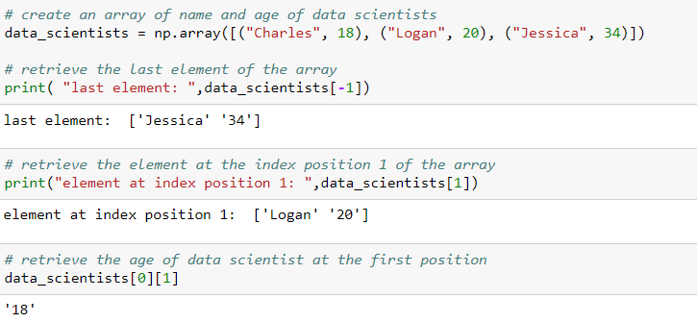
Indexing array
The element in the array can be accessed by the positional index of the element
The index for an array starts at 0 from left and at -1 starts from the right

Slide 4
Slicing Arrays

Slide 5
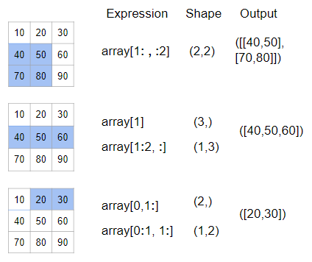
Slicing arrays

Slide 6
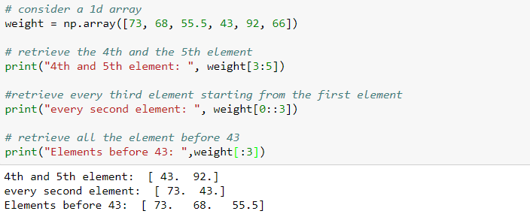
Slicing 1D array
Slicing allows us to access more than one element

Slide 7
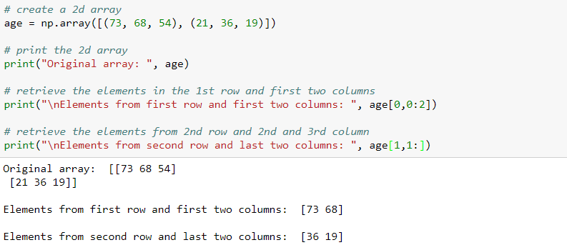
Slicing 2D array
Slicing in 2d array returns a sub-matrix of the original matrix

Slide 8
Array Operation

Slide 9
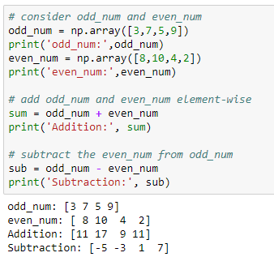
Arithmetic operations
Addition and Subtraction of 1D array

Slide 10
Arithmetic operations
Multiply each element in the array by 2

Slide 11
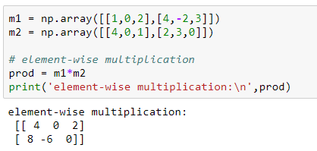
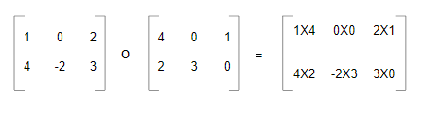
Arithmetic operations
Element-wise multiplication of two 3x3 matrices
m1
m2
m1 * m2
This product is also known as ‘Hadamard Product’

Slide 12
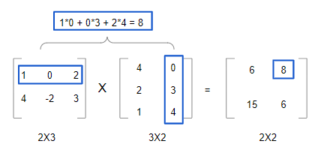
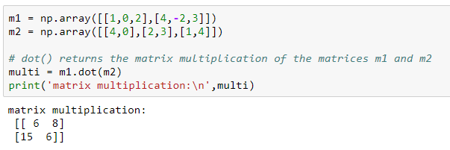
Arithmetic operations
Matrix multiplication of two 3x3 matrices

Slide 13
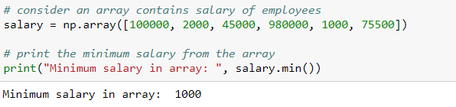
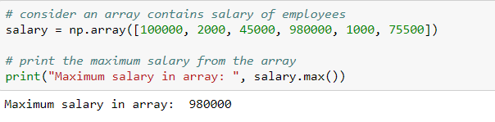
Arithmetic operations
The min() returns the minimum value present in the array
The max() returns the maximum value present in the array

Slide 14
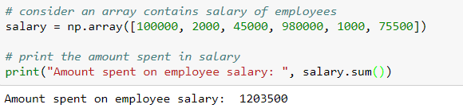
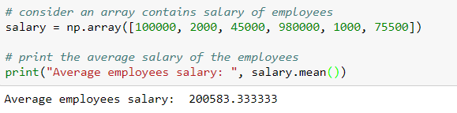
Arithmetic operations
The sum() returns the sum of all the elements in the array
The mean() returns the mean of the values in the array

Slide 15
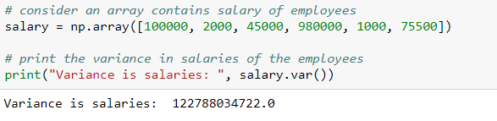
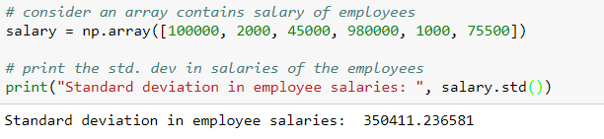
Arithmetic operations
The var() returns the variance of all the elements in the array
The std() returns the standard deviation of all the elements in the array

Slide 16
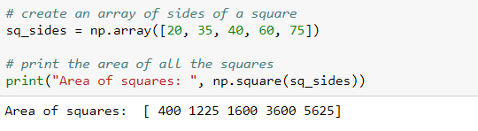
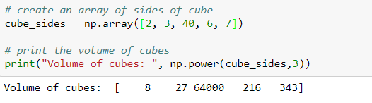
Arithmetic operations
The np.square() returns the square of the elements
The np.power() is used to raise the numbers in the array to the given value

Slide 17
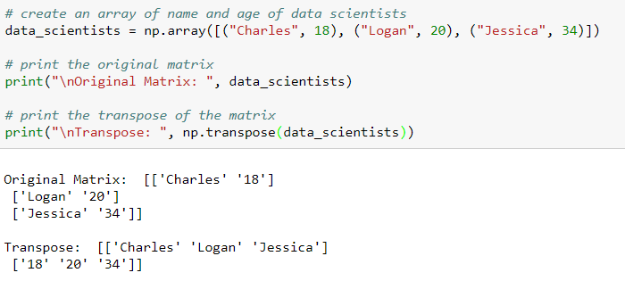
Arithmetic operations
The np.transpose() reverses the dimension of the array

Slide 18
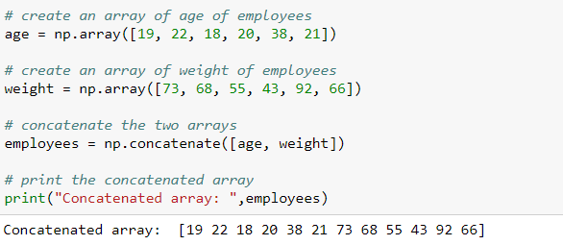
Concatenate 1D array
Two or more arrays will get joined along existing (first) axis, provided they have the same shape
Note: We cannot concatenate the arrays with different dimensions

Slide 19
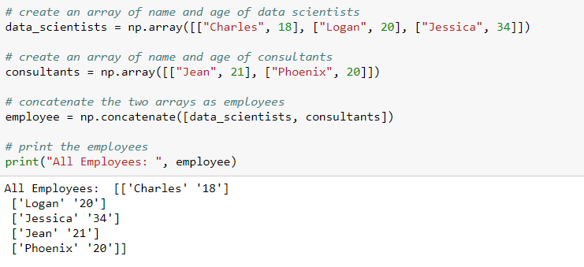
Concatenate 2D array
We can concatenate 2D arrays either along rows (axis = 0) or columns (axis = 1), provided they have same shape

Slide 20
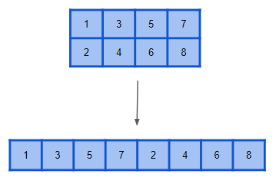
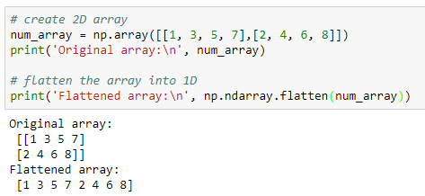
Flatten the array
The flatten() function collapses the original array into a single dimension

Slide 21
Iterating through arrays

Slide 22
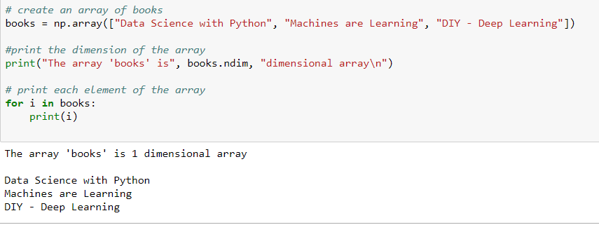
Iterating through 1D array
The for loop can be used to iterate through the array elements

Slide 23
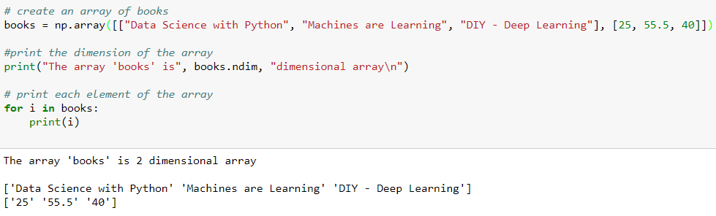
Iterating through 2D array

Slide 24
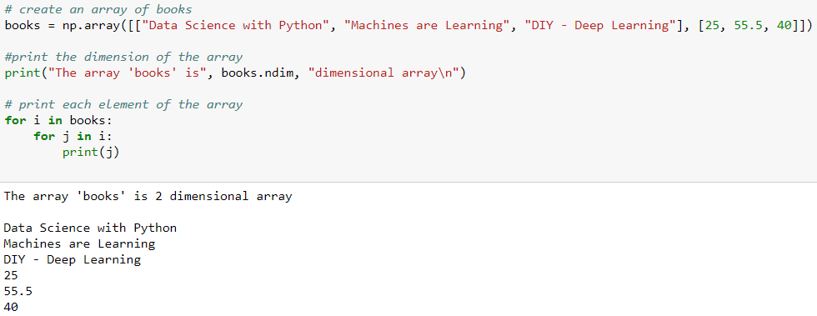
Iterating through 2D array using nested for loop
To print each element in the 2D array, use nested for loop

Slide 25
THANK YOU
Presenter’s Name
Contact Us
support@knowledgehut.com
Presenter’s Designation

